Slide 1

Department of Computer Science & Engineering
National Institute of Technology Karnataka, Surathkal
ML-Based Fast Performance Evaluation in NoCs
Presented by- Sajal Jain(192591IS024)
Guided by- Dr. Biswajit R. Bhowmik

Slide 2
Organization of the Presentation
Introduction
Related Work
SVR Framework for NoC Evaluation
Results and Analysis
Conclusion and future work

Slide 3
Introduction
MPSoCs uses number of CPUs and other hardware module to implement a system.
NoC(Network) on chip is an embedded switching network that interconnects Ip cores in SoCs. Latency, bandwidth, and power consumption requirement is not sufficiently met in bus based architecture. NoC provides parallel communication (W. Wolf, 2008).
NoC Basics
Topology type: mesh, torus etc.
Network size
Routing algorithm: Deterministic XY, oblivious, adaptive etc.
Virtual channel
Buffer Size
Traffic pattern: tornado, shuffle, uniform etc.
Packet injection rate
NoC simulators: BookSim 2.0, Nirgam, Noxim etc.
AI in NoCs- Thermal prediction, Performance evaluation.

Slide 4
Related Work
NoC design space constitutes architectural parameters( topology, network links) and dynamic configuration parameters (switching strategy, routing algorithm) that directly affects the throughput and latency.
Simulators are used to evaluate the performance of NoCs. As the topology size of NoCs increase simulation time increases (Nan Jiang et al, 2013).
Researcher have provided the use of machine learning for the customization of NoC network parameters which directly influence the performance matrix.

Slide 5
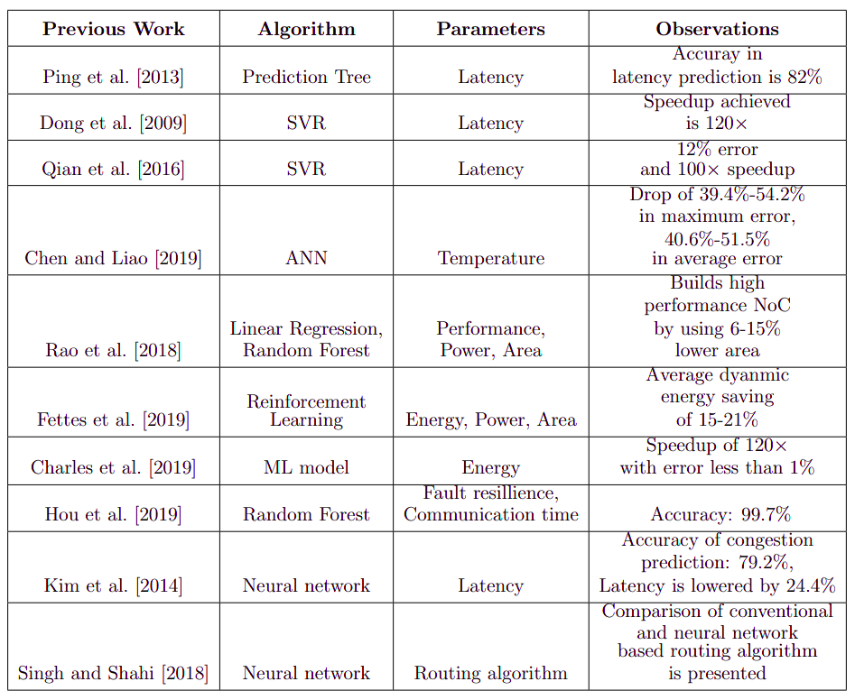

Slide 6
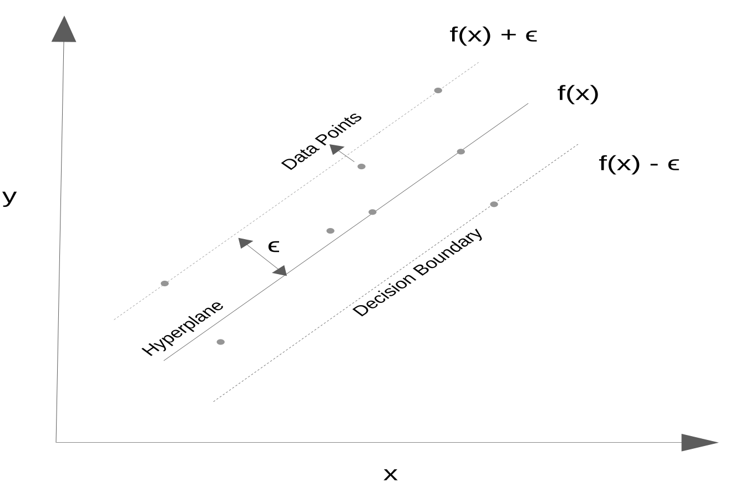
SVR Framework For NoC Evaluation
SVR tries to find the hyperplane such that maximum
points fall inside the decision boundary (Robert C.
Williamson, 2013).
Hyperplane represent the best fit curve for a
particular dataset in SVR.
Hyperparameters are C, epsilon (ϵ) and gamma(γ).

Slide 7
Designing SVR Framework
Training phase
Data is collected from BookSim 2.0 simulator by varying input features of NoC like topology size, traffic pattern, Virtual Channel, Buffer Size and injection rate. Data is recorded seperately for each of the input feature.
Hyperparameter are tuned using GridSearchCv of scikit learn.
Regression model is obtained.
Testing phase
Output parameters are latency, area and power of NoC.
Predictions are obtained on the test data.
Mean square error is calculated to find the deviation from actual simulator results.

Slide 8
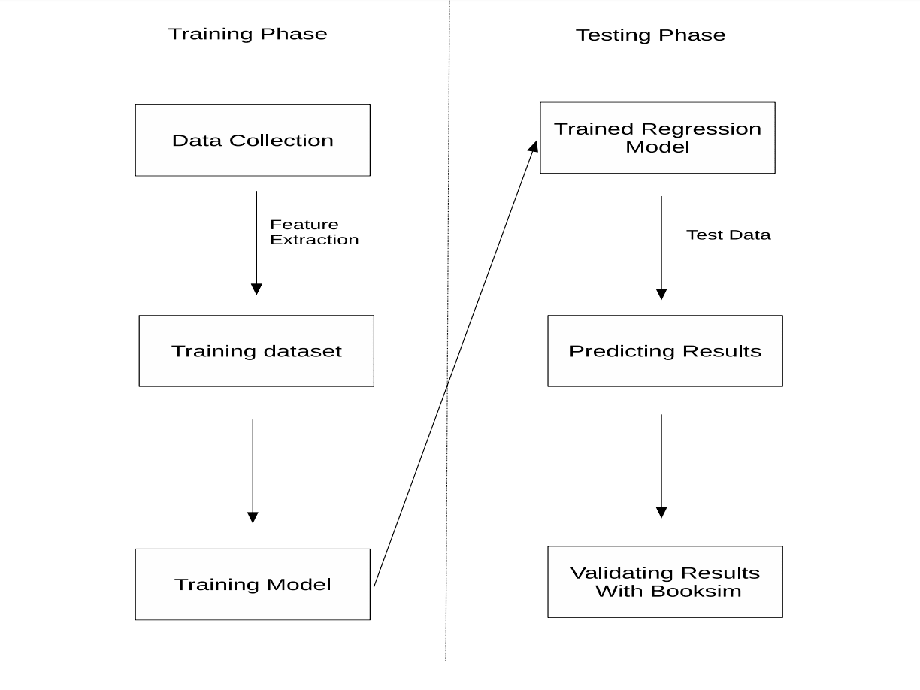

Slide 9
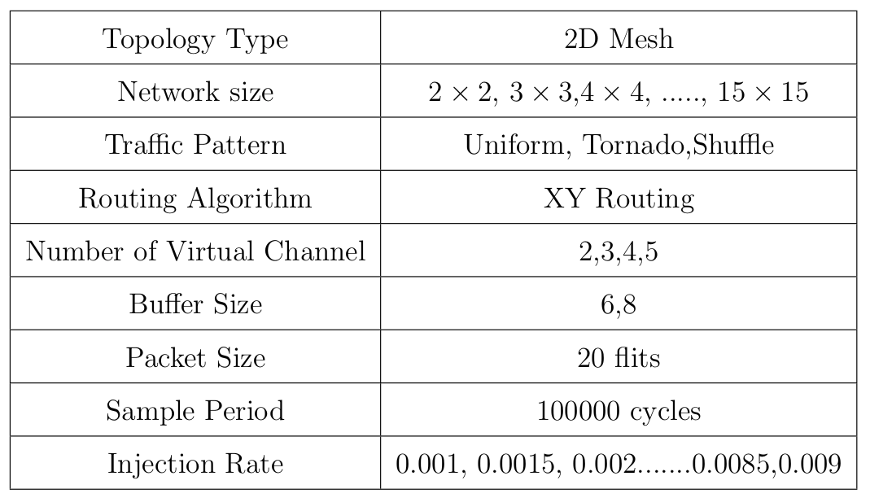
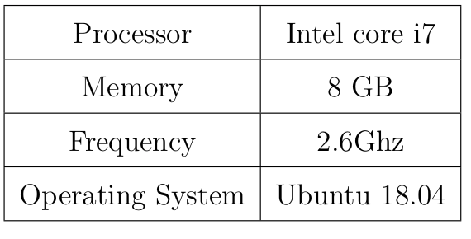
Results and Analysis
Simulation setup
Following configuration of system and BooKSim 2.0 simulator is used.

Slide 10
Results Analysis
SVR framework is used to predict NoC parameters like average packet latency, average network latency, average hop count, switch power, channel wire power and total area.
Tornado, uniform and shuffle traffic pattern are considered in results.
Results obtained vary linearly or non-linearly.
The performance parameters of NoC increases as the topology size increases, either linearly or non-linearly.

Slide 11
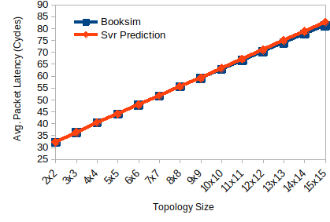
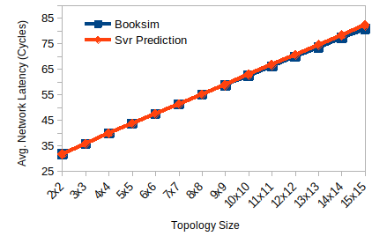
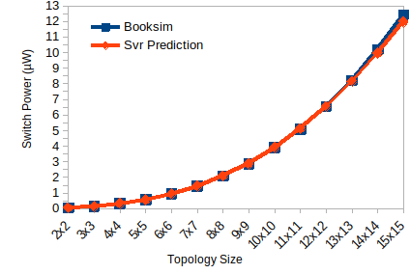
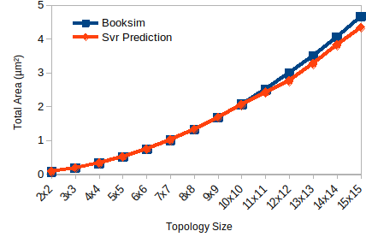
Evaluation of NoC performance metrics by the proposed SVR framework over the simulation method at virtual channel=4, buffer size=8, PIR=0.002, traffic type= uniform.

Slide 12
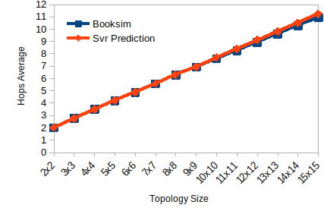
Evaluation of NoC performance metrics by the proposed SVR framework over the simulation method at virtual channel=4, buffer size=8, PIR=0.002, traffic type= uniform.

Slide 13
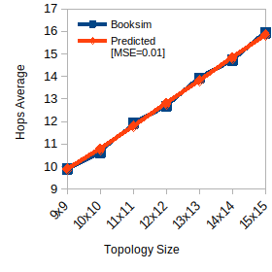
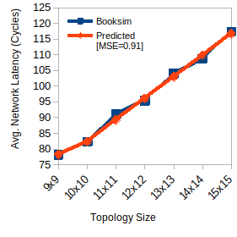
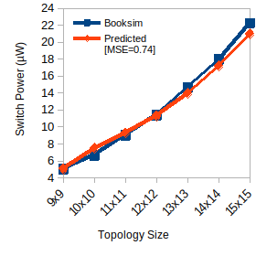
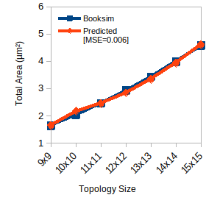
Evaluation of NoC performance metrics by the proposed SVR framework over the simulation method at virtual channel=5, buffer size=6, PIR=0.0025, traffic type= tornado.

Slide 14
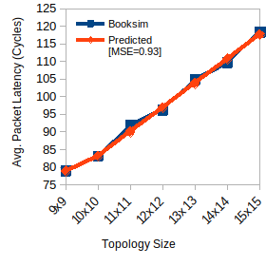
Evaluation of NoC performance metrics by the proposed SVR framework over the simulation method at virtual channel=5, buffer size=6, PIR=0.0025, traffic type= tornado.

Slide 15
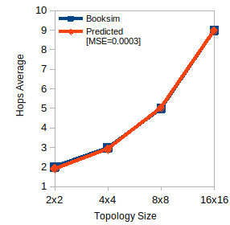
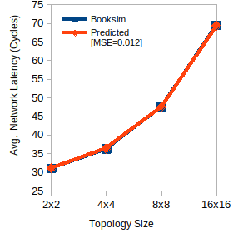
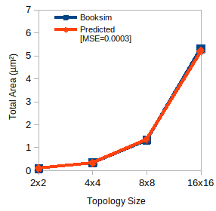
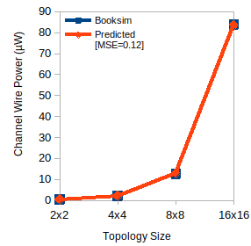
Evaluation of NoC performance metrics by the proposed SVR framework over the simulation method at virtual channel=4, buffer size=8, PIR=0.0015, traffic type= shuffle.

Slide 16
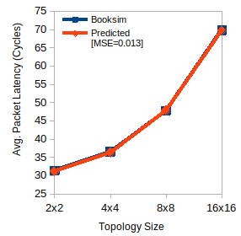
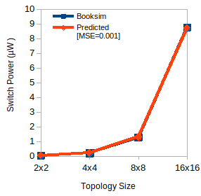
Evaluation of NoC performance metrics by the proposed SVR framework over the simulation method at virtual channel=4, buffer size=8, PIR=0.0015, traffic type= shuffle.

Slide 17
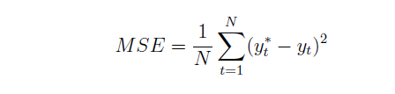
Results Validation
Comparison of framework results with simulation results is necessary for deciding its efficiency and robustness.
The value of C is varied from 1 to 25. Epsilon (ϵ) is in the range from 0.01 to 0.05 and gamma (γ) in 0.001 to 1.
For verification MSE(mean square error) is calculated. Lower the mean square error, closest is the prediction.
Equation for mean square error is given below, where N=number of data points, y*t is the actual value, yt is the predicted output

Slide 18

Timing Comparison of BookSim 2.0 and SVR Framework
The execution time of SVR and Booksim simulation time is compared and speedup is calculated.
Speedup is used to check to the the rate of improvement in the time of evaluation. The Equation below denotes the expression for speedup.
where, Ts is simulation evaluation time for Booksim simulator and Tp is evaluation time of SVR framework.

Slide 19
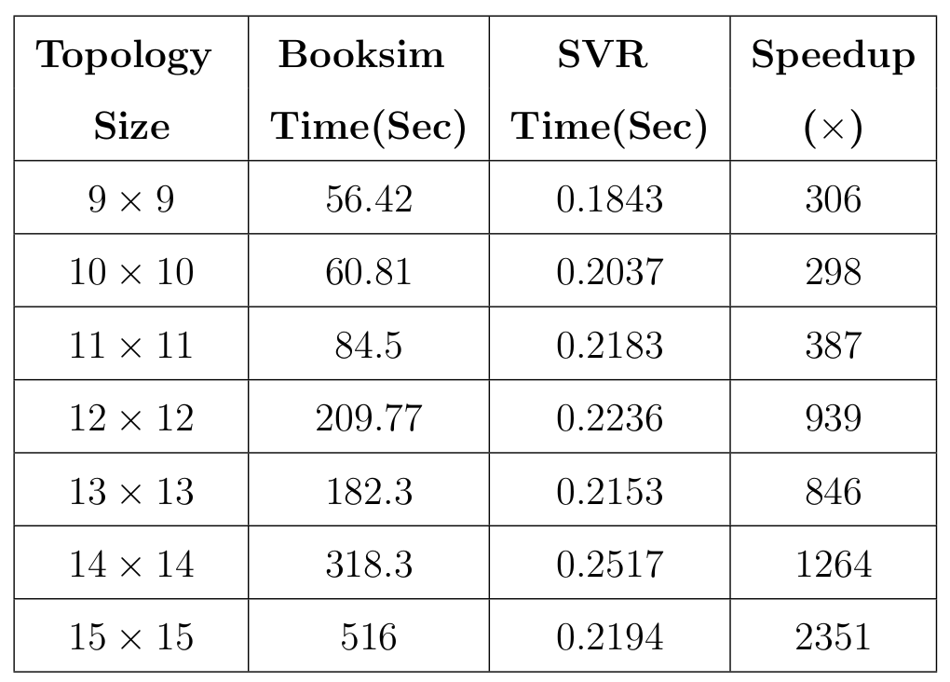
Booksim simulator and SVR algorithm timing comparison in seconds

Slide 20
Conclusion and Future Work
Conclusion
SVR Framework is built to predict the performance, power, and area parameters of NoC.
Network Sizes of 2x2 to 15x15 is considered.
Machine Learning framework predicts the parameters with a speedup of 300-2350 times over the Cycle accurate simulator.
Future Research
Topology size considered is 2x2 to 15x15, which leaves the enough scope to extend the work for higher topology sizes.
Other performance parameters of NoC can be included in framework such as throughput. Evaluation is done on latency, power and area parameters of 2D-mesh NoCs.
Model can be trained on irregular topology sizes of NoCs to evaluate the performance.
3D NoC's with topology of torus and mesh can be included in future work.

Slide 21
Bibliography
W. Wolf, A. A. Jerraya and G. Martin, "Multiprocessor System-on-Chip (MPSoC) Technology," in IEEE Transactions on Computer-Aided Design of Integrated Circuits and Systems, vol. 27, no. 10, pp. 1701-1713, Oct. 2008, doi: 10.1109/TCAD.2008.923415.
Nan Jiang et al., "A detailed and flexible cycle-accurate Network-on-Chip simulator," 2013 IEEE International Symposium on Performance Analysis of Systems and Software (ISPASS), 2013, pp. 86-96, doi: 10.1109/ISPASS.2013.6557149.
Bernhard Schölkopf, Alex J. Smola, Robert C. Williamson, and Peter L. Bartlett. 2000. New Support Vector Algorithms. Neural Comput. 12, 5 (May 2000), 1207–1245. DOI:https://doi.org/10.1162/089976600300015565
Ruturaj Pujari and Shaloo Rakheja. Performance evaluation of copper and graphene
nanoribbons in 2-d noc structures. In 2017 18th International Symposium on Quality Electronic Design (ISQED), pages 353–359. IEEE, 2017.
Zhi-Liang Qian, Da-Cheng Juan, Paul Bogdan, Chi-Ying Tsui, Diana Marculescu, and Radu Marculescu. A support vector regression (svr)-based latency model for network-on-chip (noc) architectures. IEEE Transactions on Computer-Aided Design of Integrated Circuits and Systems, 35(3):471–484, 2016. doi: 10.1109/TCAD. 2015.2474393.
Mahnaz Rafie, Ahmad Khadem-Zadeh, and Midia Reshadi. Performance improvement of application-specific network on chip using machine learning algorithms. Int. J. of High Performance Systems Architecture, 5:71 – 83, 01 2014. doi: 10.1504/IJHPSA 2014.061438.

Slide 22
THANK YOU

Slide 23


